Slide 1
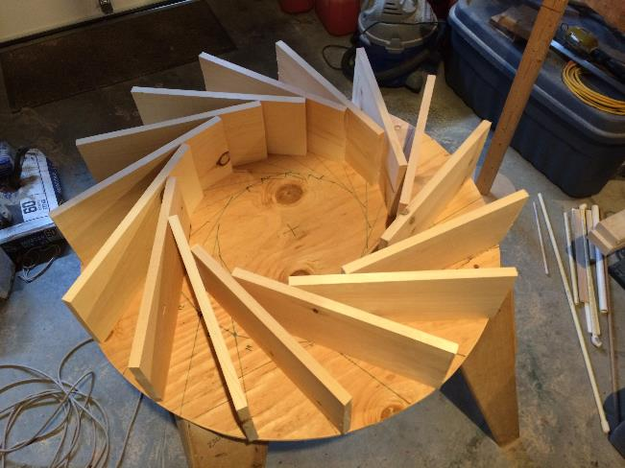
Renewable Energy
Hydroelectric - Part 2
(Build & Test)
LabRat Scientific
© 2019

Slide 2
In this lesson, we will convert the theoretical water wheel design (Lesson 1) into a working water wheel. The system will be tested to verify that the theoretical design yields a configuration that will spin with the necessary speed to generate the desired 12 VDC.
The first step is to build the water wheel…

Slide 3
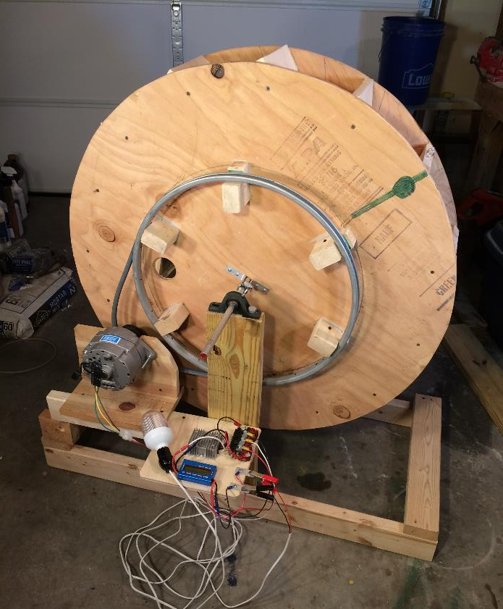
Plywood Side Disks (one on each side)
Water Compartment Vanes (15 ea.)
V-belt
Bearings (one on each side)
Bicycle Wheel Rim with Spokes Removed
Steel Axle (5/8” dia)
Alternator and Support Electronics
Temporary Stand

Slide 4
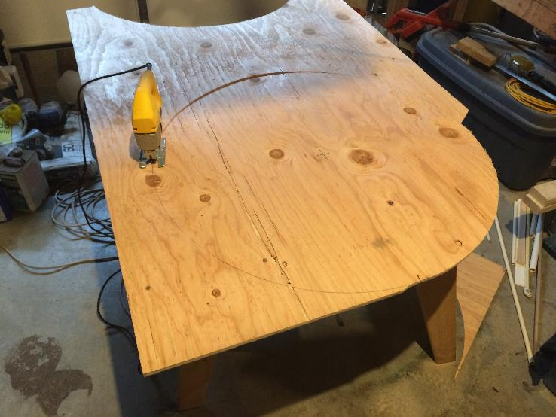
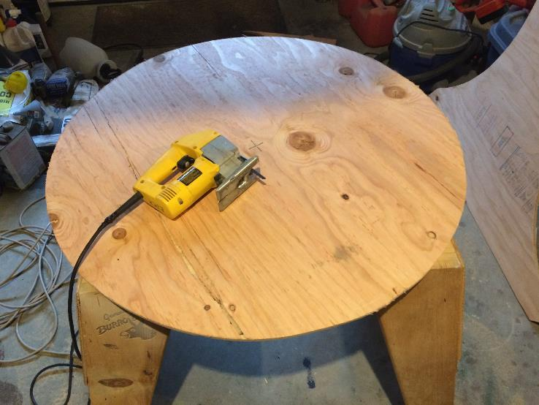
Water Wheel Fabrication
Cutting out the side disks
Completed side disk

Slide 5

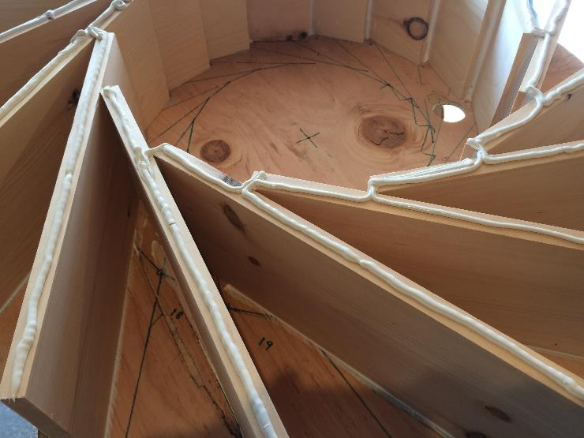
Water Wheel Fabrication
Installing the vanes
Construction adhesive applied to vanes prior to installation of other side disk

Slide 6
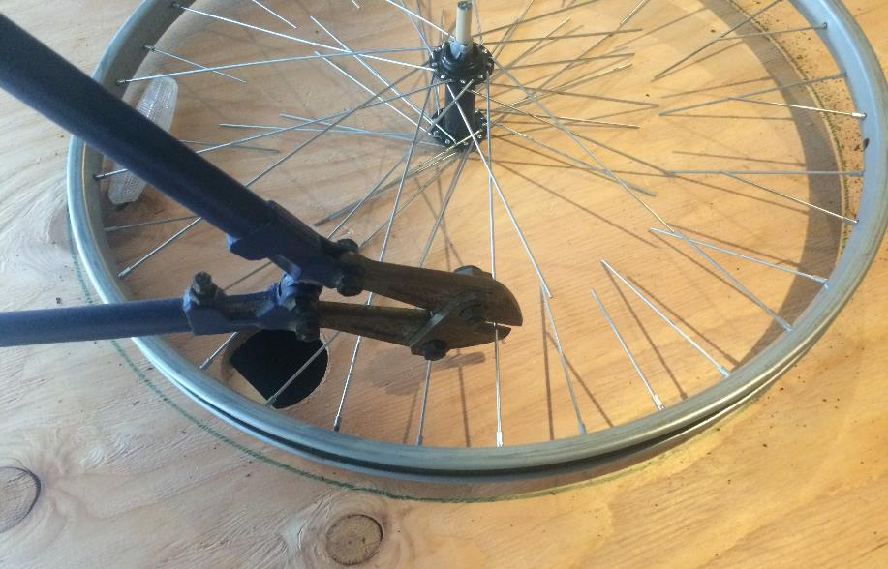
A cable cutter was used to liberate the wheel rim from its spokes

Slide 7
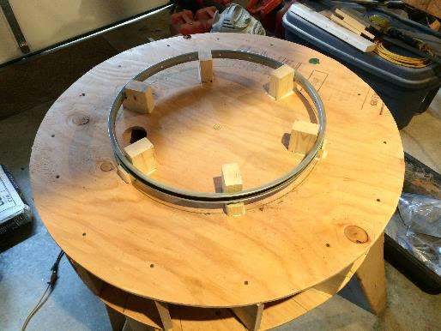
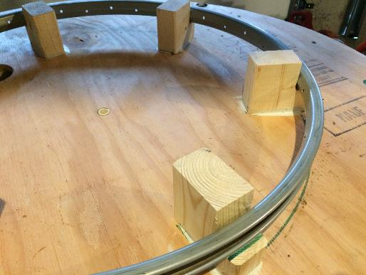
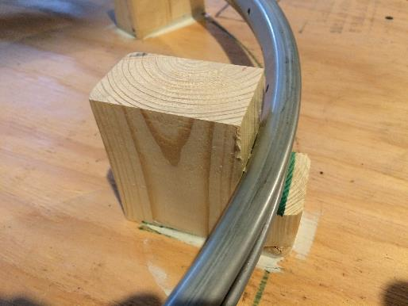
Wooden blocks were then used to interface the wheel rim to the side of the water wheel. Care was taken to ensure the rim was centered on the disk.
Screws pass through the spoke holes in the rim and into the wooden blocks.

Slide 8
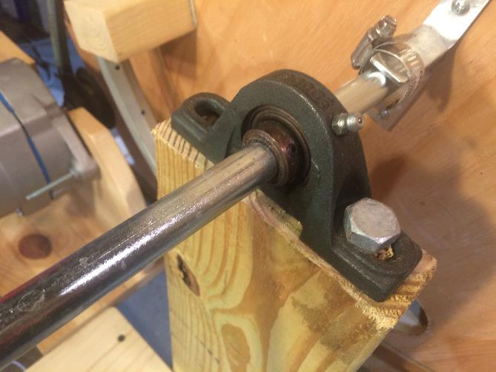
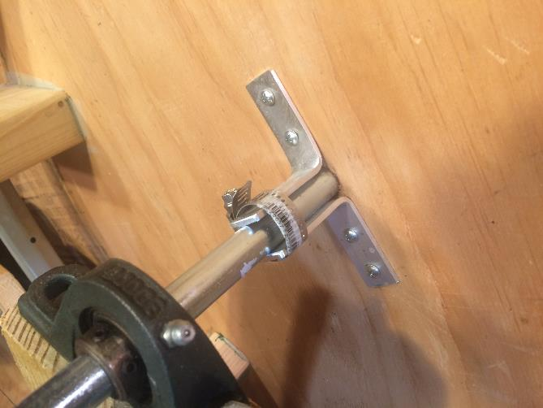
Bearing supporting the water wheel axle. One on each side of the wheel.
L-brackets and hose clamps securing the water wheel to the axle.

Slide 9
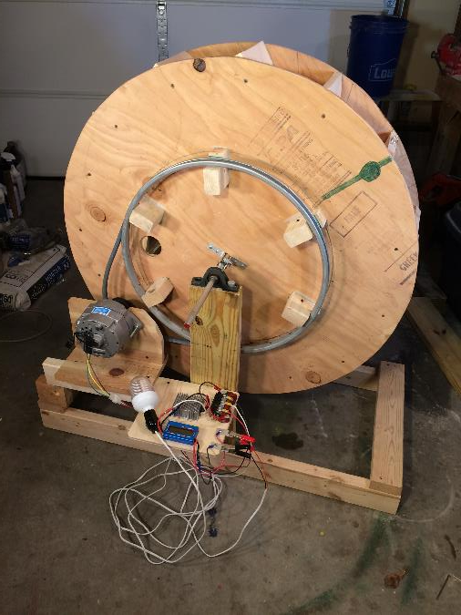
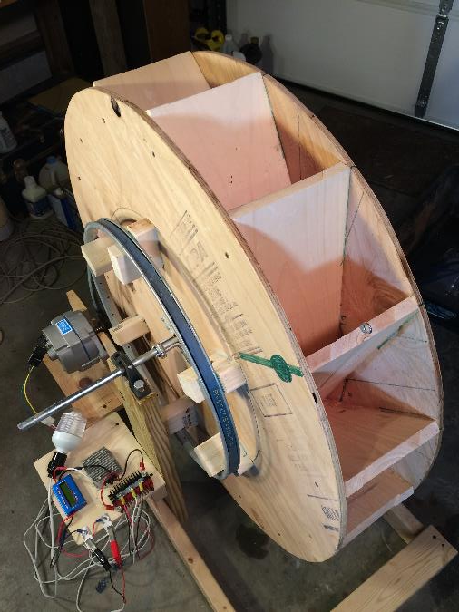
Completed Water Wheel on a support frame ready for testing

Slide 10
Assessment
of the
Torque Required to Spin the System

Slide 11
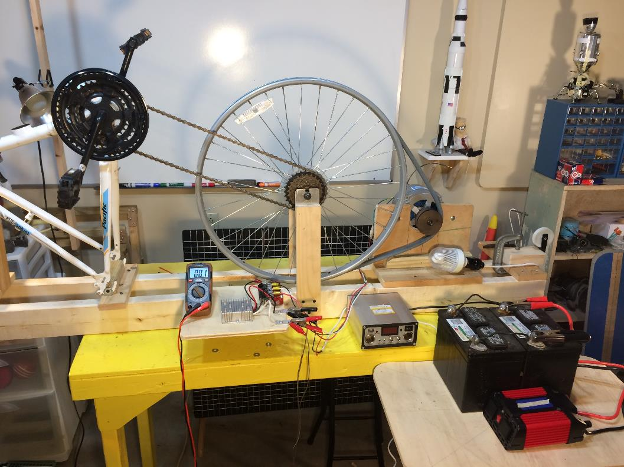
Lesson 1 presented the Test Apparatus used to determine the torque that would be needed to spin the system.
Bike Wheel
V-belt
The peddles and chain drive the bicycle wheel. A V-belt loops around the wheel and a pulley on the alternator shaft.
Alternator
The wheel and pully arrangement gives an 8:1 speed ratio (the alternator spins 8 times faster than the wheel).

Slide 12
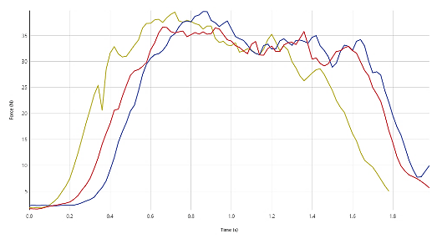
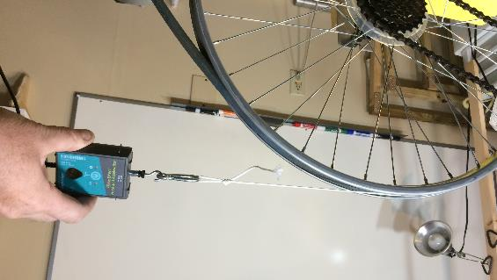
Torque Required to Spin the System
Pull Tests were conducted on the Test Apparatus to determine the Torque Required to spin the system and generate a 12 VDC electrical output.
32 N
12 VDC light bulb connected
32 N
0.28 m
Torque_{Required} = Force x Radius
Torque_{Required} = 32 N x 0.28 m = 9.0 Nm

Slide 13
Calculating the Gravitation Torque created by the water held in the water wheel

Slide 14
It was estimated that only 5 of the water wheel compartments would contain water at any given time. The geometry of the compartments was used to estimate the amount of water in each “wet” compartment. This water weight is then used to calculate the moment (torque) that would be generated by gravity (a.k.a. the Gravity Torque).

Slide 15
Approximate Weight of Water in each Wet Compartment
Water Volume₁ = ½ x 0.25 m x 0.1 m x 0.185 m = 0.0023 m³
= 2.3 Liters
1
2
3
Water Weight₁ = Density x Volume
= 9800 N/m³ x 0.0023 m³
= 22.7 N
4
For estimating purposes, it is assumed that the weight of water is the same in compartments 1, 2, 3, and 4. The weight of water in compartment 5 is estimated to be 50% of the others.
5

Slide 16
Approximating the Moment Arms for each Water Compartment
Since gravity is providing the force to rotate the wheel, the moment arm used is the horizontal distance from the axis of rotation to the Center of Gravity (CG) of each cell of water.
1
2
3
4
Estimated Moment Arms:
Compartment ₁ = 0.16 m
Compartment ₂ = 0.25 m
Compartment ₃ = 0.31 m
Compartment ₄ = 0.33 m
Compartment ₅ = 0.24 m
5

Slide 17
Calculating the Theoretical Gravitational Torque
The total torque generated by the water wheel is the sum of the torques generated by each compartment containing water. The total torque is calculated as follows:
Torque_{Supplied} = (22.7 N x 0.16 m) + (22.7 N x 0.25 m) + (22.7 N x 0.31 m) + (22.7 N x 0.33 m) + (11.4 N x 0. 24 m)
Torque_{Supplied} = (3.6 Nm) + (5.7 Nm) + (7.0 Nm) + (7.5 Nm) + (2.7 Nm)
Torque_{Supplied} = 26.5 Nm
This assumes there is sufficient time for each compartment to collect the specified volume of water.

Slide 18
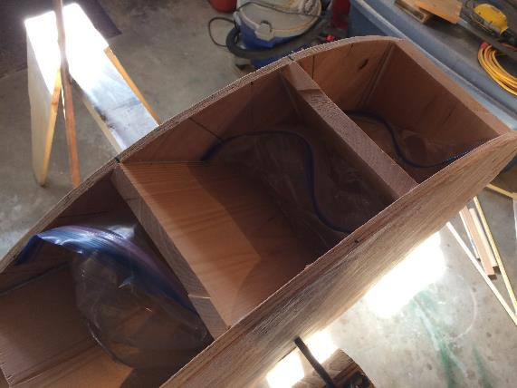
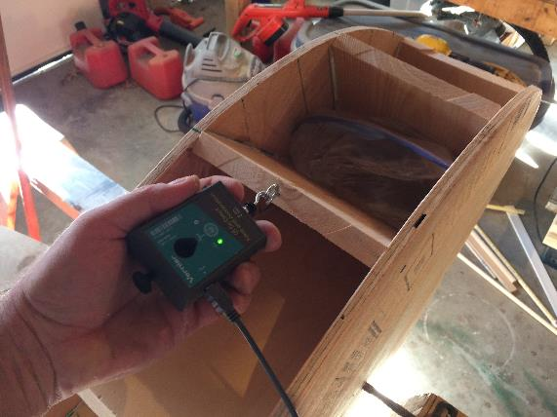
Verifying the Water Volume Provides actual Torque Predicted
Bags of water were placed in 5 water wheel compartments:
4 Compartments w/ ~22.7 N of water
1 Compartment w/ ~10.0 N of water
Measured Force at Edge of Water Wheel = 52.25 N
Torque about Axle = 52.25 N x 0.5 m = 26.1 Nm
Theoretical Gravitational Torque = 26.5 Nm
Conclusion: The actual torque generated by the volume (and associated mass) of the water matches the theoretical gravitational torque.
52.25 N

Slide 19
Assessment of Required and Supplied Torque
 | TORQUE (N*m)
Torque Required | 9.0
Torque Supplied by Water Mass | 26.5
Conclusion: The results indicate that the gravitational torque is nearly 3x greater than the torque that is required to spin the system. As such the system will spin (but will it spin fast enough?).

Slide 20
Assessment
of the Required
Wheel Rotation Rate

Slide 21
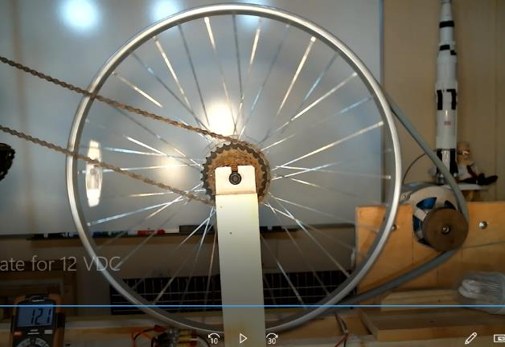
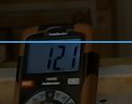
Rotation Rate needed for 12 VDC Output
An experiment was conducted on the Test Apparatus to determine the rotation rate needed to produce a steady 12.1 VDC output.
Using video data, 5 rotations of the large bike wheel were timed while the system was generating 12.1 VDC.
The 5 rotations took ~12 seconds, resulting in a spin rate of 0.42 Revolutions per Second (RPS). Since the wheel rim will be attached to the water wheel, this is also the speed at which the water wheel must spin.
Alternator Spin Rate: 8 x 0.42 rev/sec = 3.4 Rev/sec.

Slide 22
Assessment of the Gravitational Torque’s ability to generate the necessary
Rotational Velocity

Slide 23
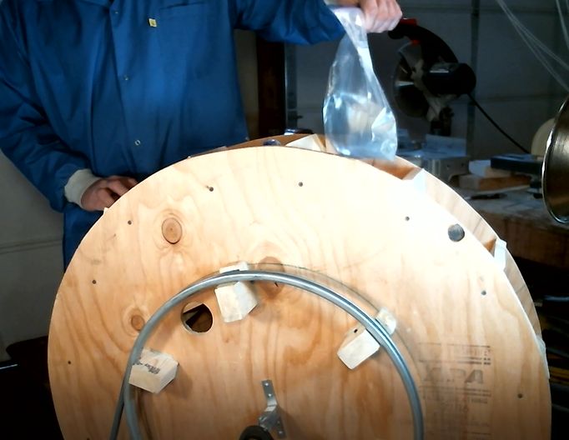
Gravitational Torque Rotation Test
5 compartments contained bags of water with the appropriate amount of water.
The water bags were free to drop out of the wheel at the bottom.
A 12 VDC light bulb was attached to the circuit to provide some electrical load.
Rotation Rate was calculated after 0.5 and 1.0 revolutions by counting video frames.

Slide 24
Gravitational Torque Rotation Test Results
It took 1.3 sec. for the wheel to rotate 0.5 revolutions giving a 0.38 rev/sec rotation rate.
Since some gravity torque was still being supplied after 0.5 revolutions, the wheel continued to accelerate. It took 2.4 sec. for the wheel to rotate 1.0 revolution giving a 0.42 rev/sec rotation rate.
Note: This is a conservative test since additional compartments will fill with water as the wheel rotates…
Conclusion: The required rotational rate of 0.42 rev/sec can be achieved solely by the gravitational torque.

Slide 25
Estimating the required
Water Flow Rate

Slide 26
Estimated Required Water Flow Rate
With the Water Wheel spinning at 0.42 revolutions/sec (required to get 12 VDC output), the time each compartment of the 15-compartment water wheel will be exposed to the water flow is estimated as follows:
rev
0.42 ----------
sec
15 compartments
X ------------------------
rev
compartments
= 6.3 ---------------------
sec
1 Compartment
Water Supply Exposure Time = -------------------------------- = 0.16 sec
6.3 Compartment/sec
2.3 Liters (amount of water in a compartment)
Required Flow Rate = ---------------- = 14.4 Liters/sec (3.8 gal/sec)
0.16 sec

Slide 27
Developing a Water Flume to Provide a Controlled Water Flow for Testing

Slide 28
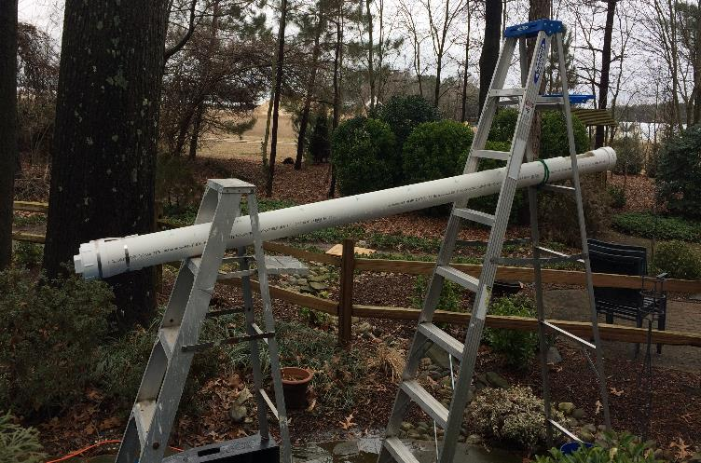
Due to the lack of a flowing water source to test the water wheel, a flume system had to be developed to provide a controlled water flow.
The full scale flume is shown in the image, but a table-top experiment was needed to test the concept and develop an analytical tool to aid in selecting full-scale test parameters.

Slide 29
Water Behavior in an Inclined Tube
T₀ = Plug Pulled
From a theoretical perspective, the water in the tube can be thought of as “packets” of water.
Gravity accelerates each packet down the tube.
This means the water draining through the tube should act like a mass sliding down a frictionless inclined plane.
Acceleration due to Gravity along the pipe
T_{D} = Tube Drained

Slide 30
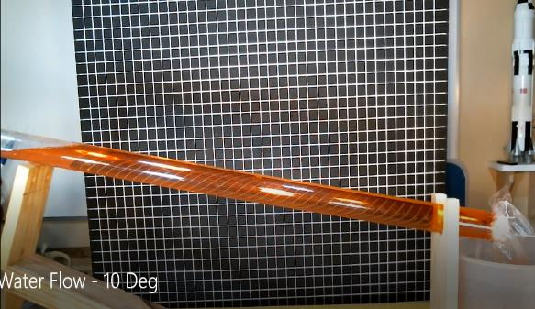
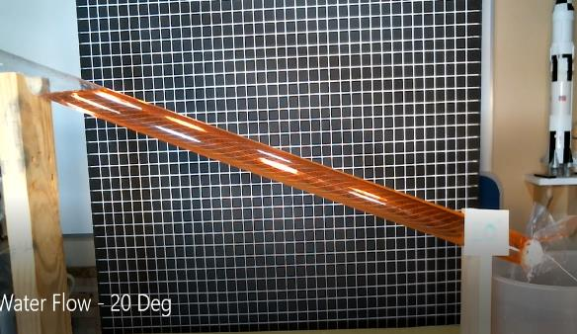
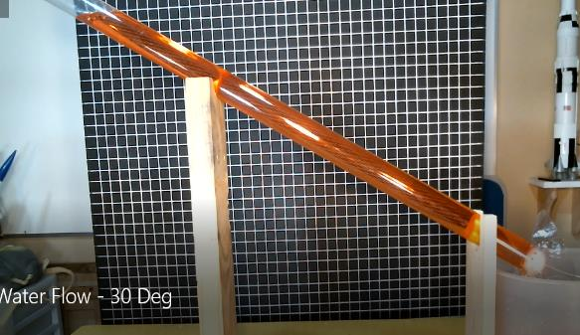
Table-top Tube Drain Tests
A table-top test apparatus was developed to understand how water would move through an inclined tube. Various incline angles were tested in an attempt to verify that water draining out of a tube would behave like a mass moving down a frictionless incline.

Slide 31
Physical Parameters of the Table-top Test Apparatus
Clear Plastic Tube
Water Column Length
Tube Dia = 0.04 m (4 cm)
Water Volume
Water rushes out when plug is removed
ϴ = Incline Angle
Configuration (Incline Angle – Deg) | Water Column Length (m) | Water Volume (m³) | Water Volume (Liters)
10 | 0.8 | 0.001 | 1.0
20 | 0.8 | 0.001 | 1.0
30 | 0.8 | 0.001 | 1.0
90 | 0.8 | 0.001 | 1.0

Slide 32
Inclined Plane Theory – Acceleration along the Incline
Acceleration = g * Sin (ϴ)
Velocity = Accel x Time
Distance = ½ x Accel x Time²
Accel = g * Cos (ϴ)
Accel = g * Sin (ϴ)
g = 9.8 m/sec2
ϴ
For a 5 Deg incline (ϴ = 5): Accel = 9.8 m/sec² x Sin (5) = 0.85 m/sec²
Applying algebra to the Distance Equation
Time to move down the incline: Time = 2 x Distance / Accel

Slide 33
Flow Velocity (5 Deg Incline)
We can use the incline plane equations to determine the velocity of the water flowing along the tube at any given time.
5 Deg Incline
These equations are derived by integrating the acceleration to get velocity and then integrating velocity to get distance.
Acceleration = 0.85 m/sec²
Velocity = 0.85 m/sec² x Time
Distance = ½ x 0.85 m/sec² x Time²
The velocity equation shows that the velocity of the water will increase over time.

Slide 34
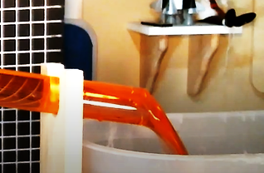
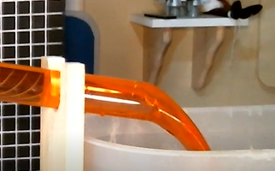
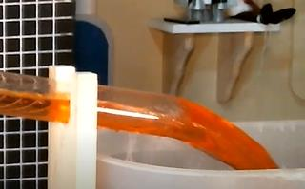
Evidence of the Flow Undergoing Acceleration
Time₁
The distance the water shoots out if the tube is an indication of the velocity of the flow in the tube.
As the images at the right show, the length of the water spout increases over time during the test, indicating that the flow velocity is changing over time.
Time₂
Time₃
10 Deg Incline

Slide 35
Results of the Inclined Tube Experiments
Incline (Deg) | Video Frames | Drain Time (Sec) | Ave Flow Rate (L/sec)
10 | ~30 | 1.00 | 1.0
20 | ~22 | 0.73 | 1.4
30 | ~17 | 0.57 | 1.8
90 | ~12 | 0.40 | 2.5
Video was captured at 30 Frames/sec.
The Flow Rate is determined by dividing the volume of water in the tube (1.0 L) by the drain time.

Slide 36
Comparing Drain Tests to Inclined Plane Calcuations
10 Deg Incline
90 Deg Incline (Vertical Drop)
Acceleration = 1.7 m/sec²
Acceleration = 9.8 m/sec²
Velocity = 1.7 m/sec² x Time
Velocity = 9.8 m/sec² x Time
Distance = ½ x 1.7 m/sec² x Time²
Distance = ½ x 9.8 m/sec² x Time²
Theoretical Descent Time: Time = 2 x Distance / Accel
Theoretical Descent Time: 0.97 sec
Actual Water Drain Time: 1.00 sec
Theoretical Descent Time: 0.40 sec
Actual Water Drain Time: 0.40 sec
CONCLUSION: The water does indeed move in exactly the same way as a frictionless mass descending along an inclined plane.

Slide 37
Applying the Theory
to the
Full-scale PVC Flume

Slide 38
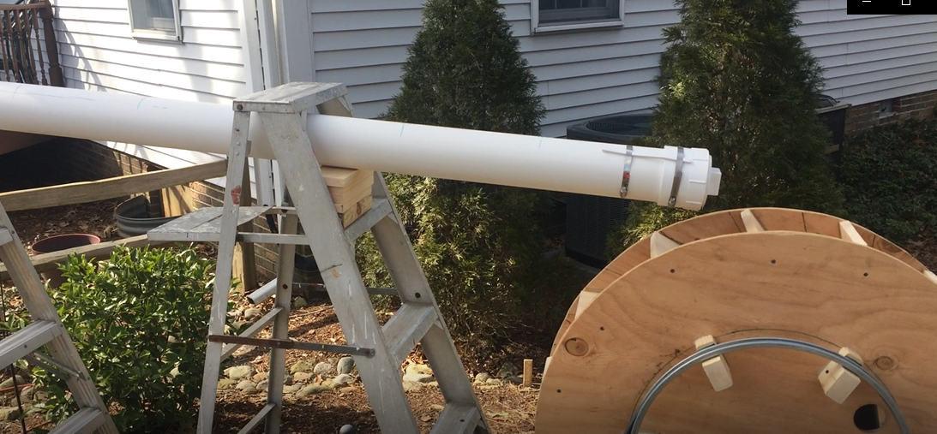
Full-scale Flume Test
Test Flume (4” Dia PVC Pipe)
Test Set-up

Slide 39
Full-scale Flow Tube (5 Deg Incline)
10 cm (4 in) Dia PVC Pipe
Cross-sectional Area of PVC Pipe:
Area = pi x Radius²
= 3.1416 x (.05 m)²
= 0.0079 m²
2.5 m
ϴ
Acceleration Due to Gravity acting along Tube at 5 Deg incline:
Accel = g * Sin (ϴ)
= 9.8 * Sin(5)
= 0.85 m/sec²
Volume of Water in PVC Pipe:
Volume = pi x Radius² x Length
= 3.1416 x (.05 m)² x 2.5 m
= 0.02 m³ (20 L)

Slide 40
Full-scale Flow Tube (5 Deg Incline)
Predicted Drain Time:
Distance = ½ x Accel x Time²
2 x Distance
Time = ------------------
Accel
The drain time is determined by calculating the time it takes the water to move out of the tube (2.5 meters for the full-scale flow test).
2 x 2.5 m
Time = ------------------
0.85 m/sec²
Time = 2.4 sec

Slide 41
Full-scale Flume (5 Deg Incline)
Theoretical Maximum Flow Velocity:
Velocity = Accel x Drain Time
This is the theoretical velocity of the last bit of water as it flows out of the tube.
Velocity = 0.85 m/sec² x 2.4 sec
Velocity = 2.0 m/sec
Theoretical Average Volumetric Flow Rate:
Multiplying the maximum flow velocity by the cross-sectional area of the tube yields an approximate maximum volumetric flow rate.
Flow Rate = Velocity x Area
Flow Rate = 2.0 m/sec x 0.0079 m²
Flow Rate = 0.016 m³/sec (16 L/sec)
This estimate assumes the water is moving through the tube as a homogeneous cylinder – which is unrealistic. However, the approach generates a reasonable first approximation for the maximum volumetric flow rate.

Slide 42
Flow Velocity Spreadsheet (5 Deg Incline)
The incline plane equations can be incorporated into a simple spreadsheet to aid in determining the proper water volume and incline needed for the test. The spreadsheet calculates the drain time as well as the flow velocity and flow rate over time.
Acceleration = 9.8 m/sec2 * Sin (ϴ)
2 x Distance
Drain Time = ------------------
Accel
Time = Time + 0.2
Velocity (m/sec) = Acceleration x Time
Flow Rate (m³/sec) = Velocity x Area
Flow Rate (L/sec) = Flow Rate (m³/sec) x 1000

Slide 43
Flow Velocity (5 Deg Incline)
Tube Drained
Gravity accelerates the water as it moves along the inclined tube.
Plug Pulled

Slide 44
Volumetric Flow Rate (5 Deg Incline)
Tube Drained
The volumetric flow rate is obtained by multiplying the flow velocity by the cross-sectional area of the tube.
Plug Pulled

Slide 45
Volumetric Flow Rate (5 Deg Incline)
The total volume of water that moves through the tube can be determined by calculating the area under the flow curve.
Area = Volume
Volume = ½ x base x height
Volume = ½ x 2.4 sec x 16.1 L/sec
Volume = 19.3 Liters
Conclusion: This value (19.3 L) is close to the volume of water (20 L) actually placed in the flume for the test. This indicates that the approximating approach is sound and thus can be used to establish test parameters.

Slide 46
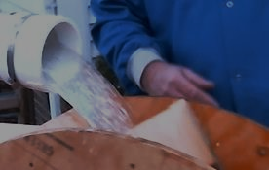
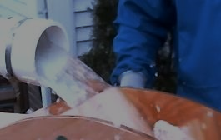
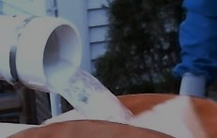
Full-scale Flume Behavior
Test Video Observations
Start of Flow
T = 0.2 sec
The actual drain time was nearly identical to the theoretical drain time.
The flow rate is not linear as the theory predicts. The flow rate coming out of the tube initially is low, then builds to a maximum, then tappers off once again just before the tube is fully drained.
Maximum Flow
T = 1.2 sec
These two observations can be used to approximate a more accurate representation of the actual flow rate during the test.
End of Flow
T = 2.3 sec

Slide 47
Refined Flume Flow Rate Estimation
The approximated Actual Flow Rate Curve (Gold) can be established by applying some engineering judgement:
Drain time is accurate.
Areas under the curves (total volumes) need to be the same.
Flow rate curve is symmetrical relative to time with the maximum flow halfway through the draining process.
This results in an approximated maximum flow rate of 14 Liters/sec.

Slide 48
Flow Rate Assessment
 | Flow Rate (L/sec)
Estimate Flow Rate Required | 14.4
Estimated Max Flow from Flume Test | 14
Conclusion: The flume, when inclined at 5 Deg with a water volume of 20 L, appears to be able to provide a flow rate for a short period of time (~0.5 sec) that is equivalent to the required flow rate.

Slide 49
Final Testing of the Hydroelectric Generator

Slide 50
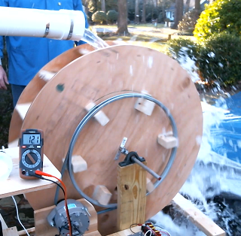
Full-scale Flume Test Results
The rotation rate was determined by counting video frames. The wheel achieved a rotation rate of ~0.5 rev/sec. This is greater than the 0.42 rev/sec required.
The voltmeter shows that the desired 12.1 VDC is being generated.
Conclusion: The system functions as designed!

Slide 51

Excess rotational velocity is a good thing, but why did the system spin faster than predicted?

Slide 52
Other Factors Contributing to the Spin of the Wheel
Flow Momentum:
Experiments demonstrated that the gravitational torque is just sufficient to spin the wheel at the required speed. However, there is another force that comes into play. This force is caused by the velocity and mass of the water imparting momentum to the water wheel vanes. This additional force provides margin that ensures the wheel will spin as desired.
Newton’s Laws of Motion:
As the gravity and momentum forces are applied over time, the wheel’s rotational velocity will increase. This will continue until the driving forces become balanced with the resistive forces and a constant velocity is achieved.

Slide 53
Questions ?

